Slide 1
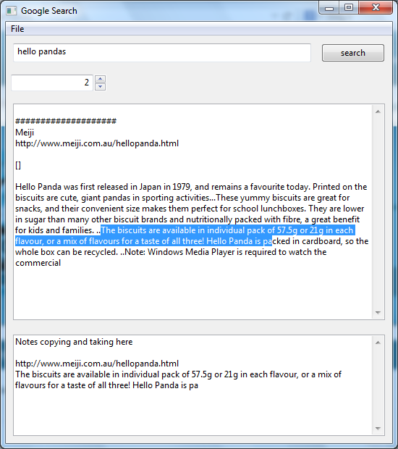
Save the notes taking portion
Scroll the results
Display the results here based on the counter stated
Copy and add notes based on the results above. Can be saved.

